Slide 1

LIBRARY
MANAGEMENT SYSTEM
Presented by
GAURAV MEHRA
Notes:
NOTE:
To change the image on this slide, select the picture and delete it. Then click the Pictures icon in the placeholder to insert your own image.

Slide 2

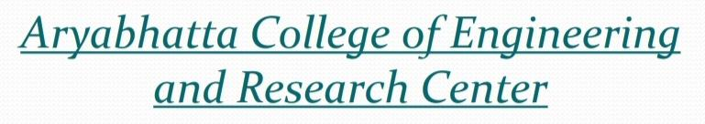
LIBRARY MANAGEMENT SYSTEM

Slide 3

LIBRARY MANAGEMENT SYSTEM
Aim ::
To develop a project titled “LIBRARY MANAGEMAENT” and is developed to maintain the operation done in a library.
Ease the work done in library by computerizing the whole system.

Slide 4
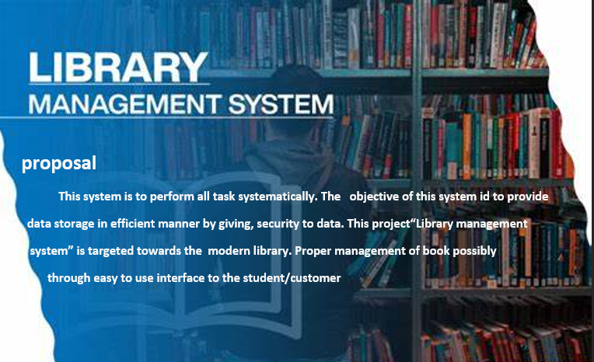


Slide 5
LIBRARY MANAGEMENT SYSTEM
LANGUAGE USED : C++
THE C++ CODE USED FOR LIBRARY MANAGEMENT SYSTEM, INCLUDES FILE SYSTEM ACCESS, SO ALL THE DATA GETS STORED IN EXTERNAL “.txt” FILE THAT WILL BE CREATED DURING RUNTIME
INCREAMENT :
This modal based on file handling now. We have develop the MYSQL database in the future and manage all data on MYSQL server.

Slide 6
LIBRARY MANAGEMENT SYSTEM
BENEFITS :
Correctness-The result of the function are accurate.
Flexibility-The operation may be flexible.
Less paper work.
Secured and consistent database.
Faster performence.

Slide 7
LIBRARY MANAGEMENT SYSTEM
MODULES :
BOOKSHOP : This module used by owner/manager of any book shop. In this we have
manage data of books which sale, purchase and search any book.
Collage library : This module used by school/collage library. Its module collect data
of student, books, issue book, submit books, new student entry data.
Library : This module used by library owner in which data collection of costumer name.

Slide 8
LIBRARY MANAGEMENT SYSTEM
CONCLUSION :
The Library Management System allows the user to store the book details and the person’s details. • This software allows storing the details of all the data related to library.
• The implementation of the system will reduce data entry time and provide readily calculated reports

Slide 9
THANKS FOR WATCHING

